Slide 1

IoT Army of 300
Resource Development to enable Our Brightest Minds in Technology
Abdur Rahman
Lecture 10
Serial Communication
Dec 13, 2017

Slide 2



Serial Communication
MCU-2
Speaker
MCU-1
Speaker
Control Line
Rx / Ear
Tx / Mouth
Data line
Data line
Rx / Ear
Tx / Mouth

Slide 3
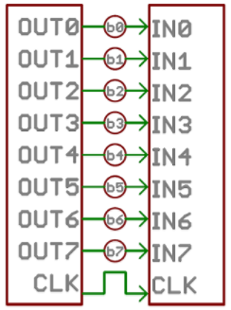
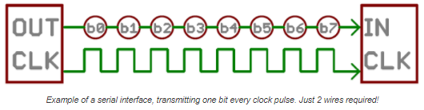
Parallel vs. Serial
Parallel
Parallel interfaces transfer multiple bits at the same time. They usually require buses of data - transmitting across eight, sixteen, or more wires. Data is transferred in huge, crashing waves of 1’s and 0’s.
Serial
Serial interfaces stream their data, one single bit at a time. These interfaces can operate on as little as one wire, usually never more than four.
An 8-bit data bus, controlled by a clock, transmitting a byte every clock pulse. 9 wires are used.

Slide 4
Serial Communication
Tutorial:
https://learn.sparkfun.com/tutorials/serial-communication

Slide 5
Serial Communication

